Slide 1

Cooling Load Estimation of New SAC Building
Department of Mechanical Engineering
Presented By
Gaurav Kumar (214103327)

Slide 2
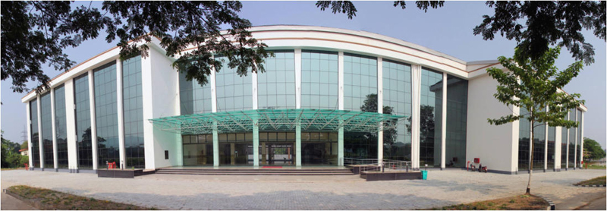
New SAC Building IITG

Slide 3
Principles modes of heat transfer
Conduction
Convection
Radiation
Design condition
Outdoor design condition:
At peak time, typical Guwahati DBT 98.6 ˚F(37˚C), and 80% RH
Indoor design condition: based upon human comfort
at peak time DBT= 75.2˚F(24˚C), 50% RH

Slide 4
Space Characteristics
Lightening
Ceiling
Surrounding condition
Window
Occupants
Appliances
Orientation of building
Size of building

Slide 5
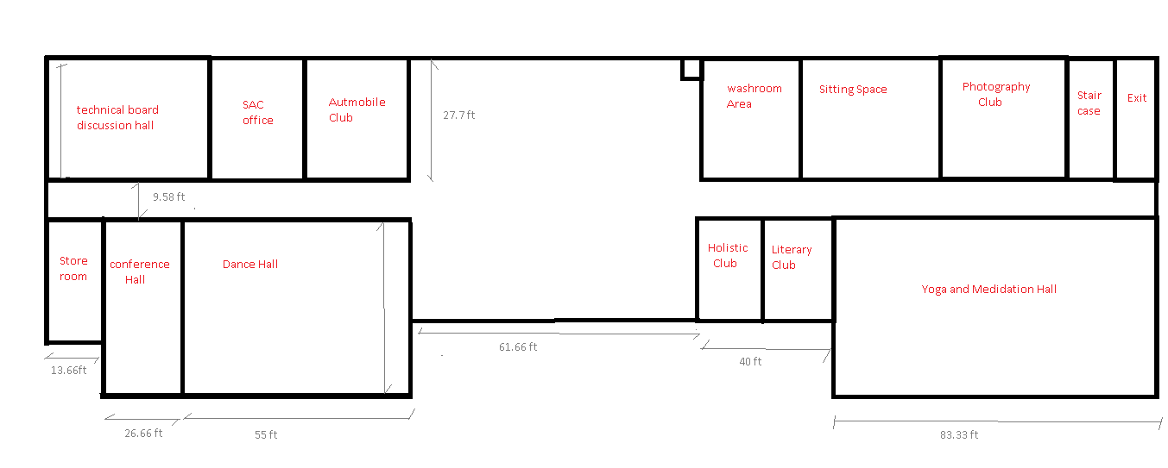
New SAC Building Layout

Slide 6
Cooling load calculations
Equation used for cooling load temperature difference correction
CLTD_{C} = [CLTD + (78 – TR) +(TM – 85)]
Where
TR= inside design temp=75.2 ˚ F
Daily range= max DBT- min DBT
= 98.6-77 = 21.6F
TM=Mean outdoor temp= Max outdoor temperature-(Daily range/2)
= 98.6-21.6/2 = 87.8˚ F (31˚ C )

Slide 7
CLTD and CLTDc for different walls
Walls | CLTD | CLTDc
North Wall | 21 | 26.6
South Wall | 26 | 31.6
East Wall | 33 | 38.6

Slide 8
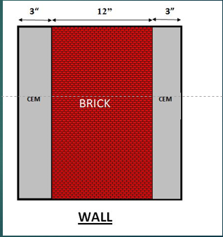
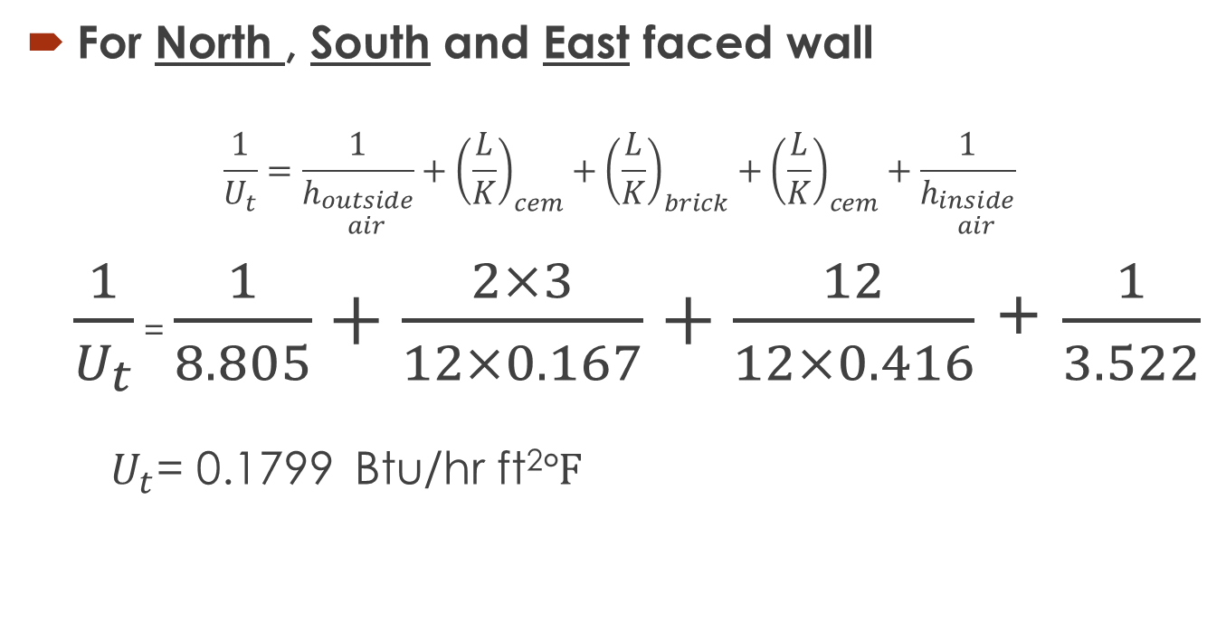
Calculation of heat transfer coefficient
For North , South and East faced wall
$$\frac{1}{U_{t}}=\frac{1}{h_{\begin{aligned}outside \\ air\end{aligned}}}+{\left(\frac{L}{K}\right)}_{cem}+{\left(\frac{L}{K}\right)}_{brick}+{\left(\frac{L}{K}\right)}_{cem}+\frac{1}{h_{\begin{aligned}inside \\ air\end{aligned}}}$$
$\frac{1}{U_{t}}$ = $\frac{1}{8.805}+\frac{2×3}{12×0.167}+\frac{12}{12×0.416}$ + $\frac{1}{3.522}$
$U_{t}$= 0.1799 Btu/hr ft²$℉$

Slide 9
CALCULATION OF HEAT LOAD THROUGH WALLS
Q=U*A*CLTDc
Wall | Area(sq.ft) | CLTDc | U(Btu/hr.ft.² F) | Q(Btu/hr)
North Wall | 2490 | 26.6 | 0.1799 | 11915.5
South Wall | 2490 | 31.6 | 0.1799 | 14155.25
East Wall | 6318 | 38.6 | 0.1799 | 43873.08

Slide 10
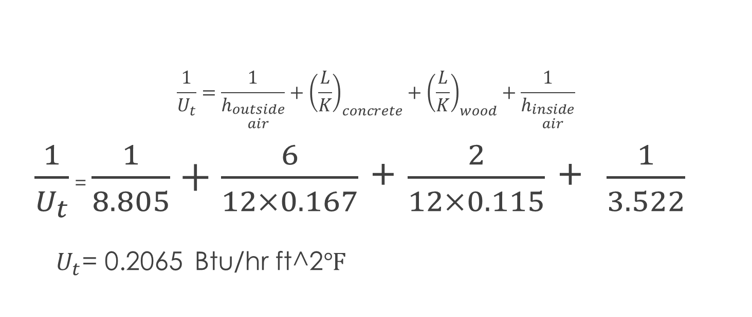
Calculation of heat transfer coefficient for roof
$$\frac{1}{U_{t}}=\frac{1}{h_{\begin{aligned}outside \\ air\end{aligned}}}+{\left(\frac{L}{K}\right)}_{concrete}+{\left(\frac{L}{K}\right)}_{wood}+\frac{1}{h_{\begin{aligned}inside \\ air\end{aligned}}}$$
$\frac{1}{U_{t}}$ = $\frac{1}{8.805}+\frac{6}{12×0.167}$ + $\frac{2}{12×0.115}$ + $\frac{1}{3.522}$
$U_{t}$= 0.2065 Btu/hr ft^2$℉$

Slide 11
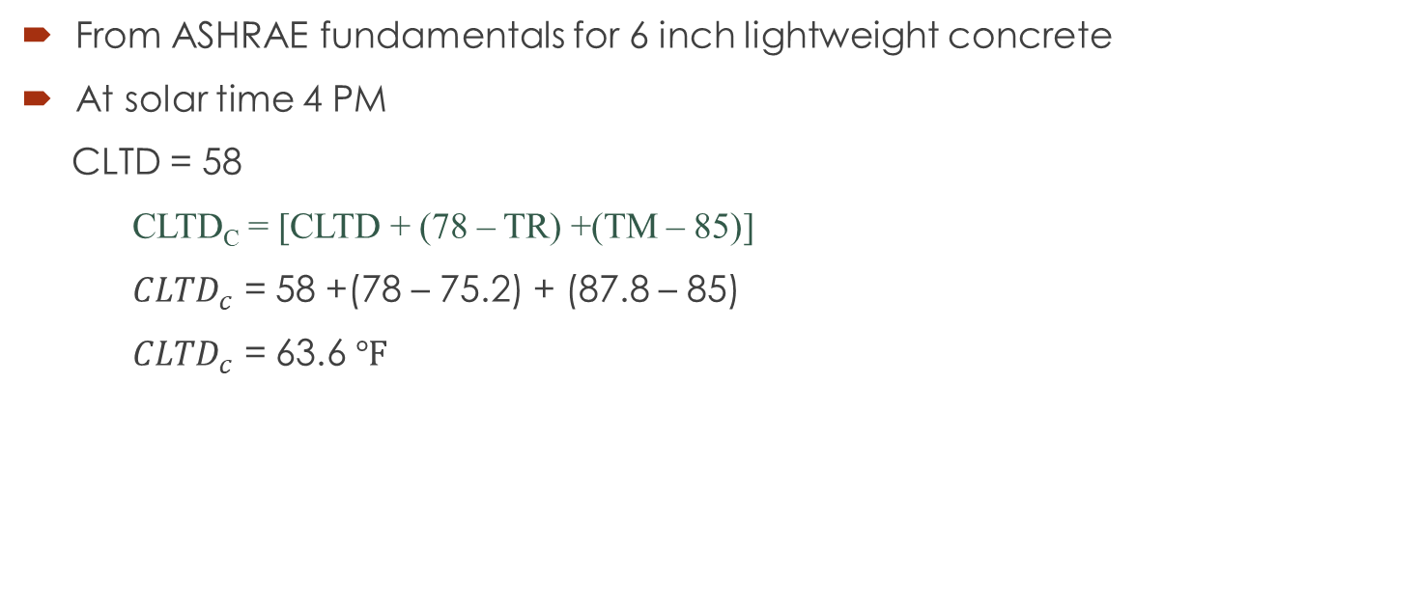

Calculation of ${CLTD}_{c}$ for Roof
From ASHRAE fundamentals for 6 inch lightweight concrete
At solar time 4 PM
CLTD = 58
CLTD_{C} = [CLTD + (78 – TR) +(TM – 85)]
${CLTD}_{c}$ = 58 +(78 – 75.2) + (87.8 – 85)
${CLTD}_{c}$ = 63.6 $℉$

Slide 12
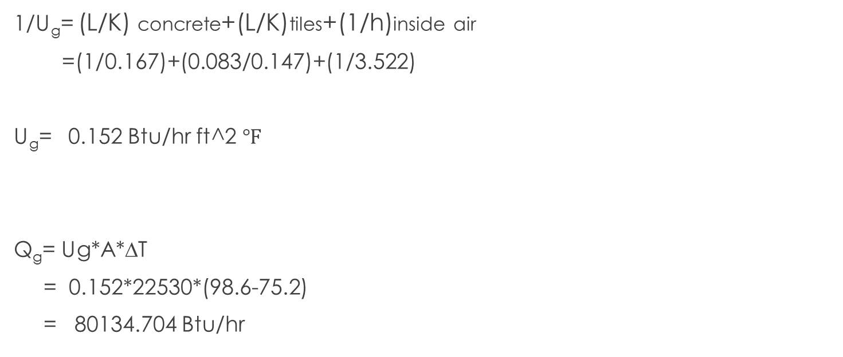
HEAT LOAD THROUGH GROUND
1/U_{g}= (L/K) concrete+(L/K)tiles+(1/h)inside air
=(1/0.167)+(0.083/0.147)+(1/3.522)
U_{g}= 0.152 Btu/hr ft^2 $℉$
Q_{g}= Ug*A*∆T
= 0.152*22530*(98.6-75.2)
= 80134.704 Btu/hr

Slide 13
HEAT GAIN THROUGH FRONT WALL(west)
(Front wall consisting of Entrance glass, Wall glass.)
Heat transfer through CONDUCTION
 | Type | Area(ft²) | U | CLTD | CLTDc | Q
Wall Glass | Reflective 6mm | 6012 | 0.83 | 14 | 19.6 | 97803.216
Entrance door glass | Single glazed | 600 | 0.88 | 14 | 19.6 | 10348.8

Slide 14
HEAT GAIN THROUGH FRONT WALL(west)
Heat transfer through RADIATION
Qrad =A*SC*SCL (SCL= CLF x max SHGF)
SC = Shading coefficient
SCL= Solar cooling load factor = CLF x maximum SHGF
 | Area | SC | CLF | Max SHGF | SCL | Q_{rad}
Wall Glass | 6012 | 0.27 | 0.82 | 196 | 160.72 | 260887.133
Entrance Glass | 600 | 0.57 | 0.82 | 196 | 160.72 | 54966.24

Slide 15
Heat gained through Window, Exit door (East)
Conduction load
 | Type/Numbers | Area | U | CLTD | CLTDc | Q
Window | Reflective/25 | 750 (3.75*8*25) | 0.83 | 14 | 19.6 | 12201.00
Exit Door | Single Glazed | 300 | 0.88 | 14 | 19.6 | 5174.4
Radiation Load
 | Area | SC | CLF | MAX SHFG | SCL | Q_{rad}
Window | 750 | 0.27 | 0.8 | 196 | 156.8 | 31752
Exit Door | 300 | 0.57 | 0.8 | 196 | 156.8 | 26812.8

Slide 16

Heat gain through lights, peoples and electronic appliances
CALCULATION OF LIGHTENNG LOAD
Lightning Load(Ql) =Rule of Thumb(Watt/sq.ft)*Area(Sq.ft)*CLF
Assumptions: CLF=0.45 (Heavy weight simple furnishing )
LOAD THROUGH APPLIANCE
${ Q}_{app}$= RATING*CLF
CLF= 0.35
CALCULATION OF OCCUPANCY LOAD
Qs= No. of people*SHG*CLF
QL= No. of people*LHG

Slide 17
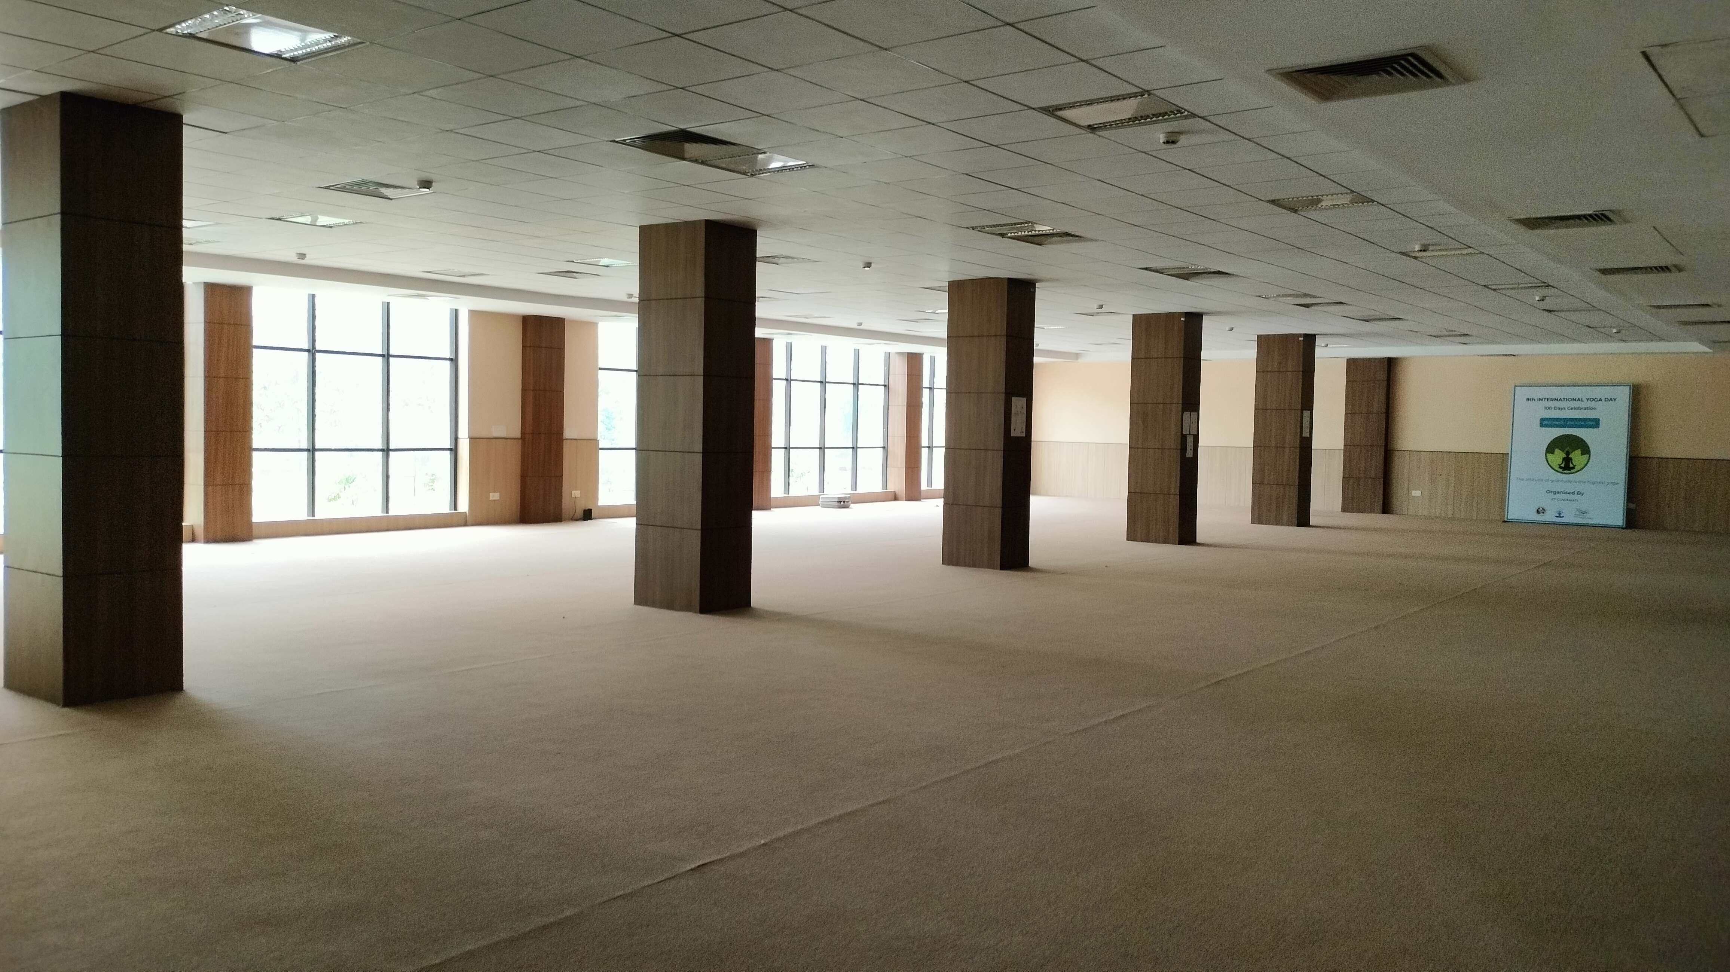
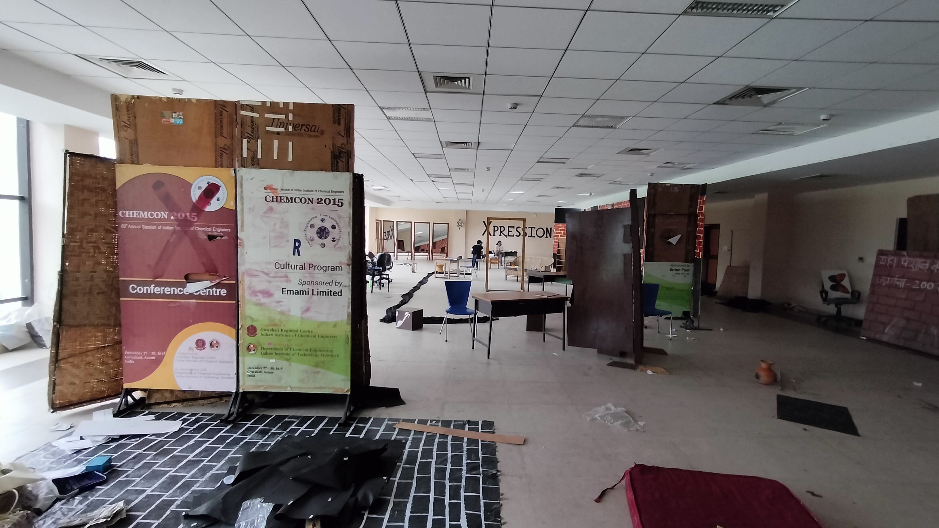
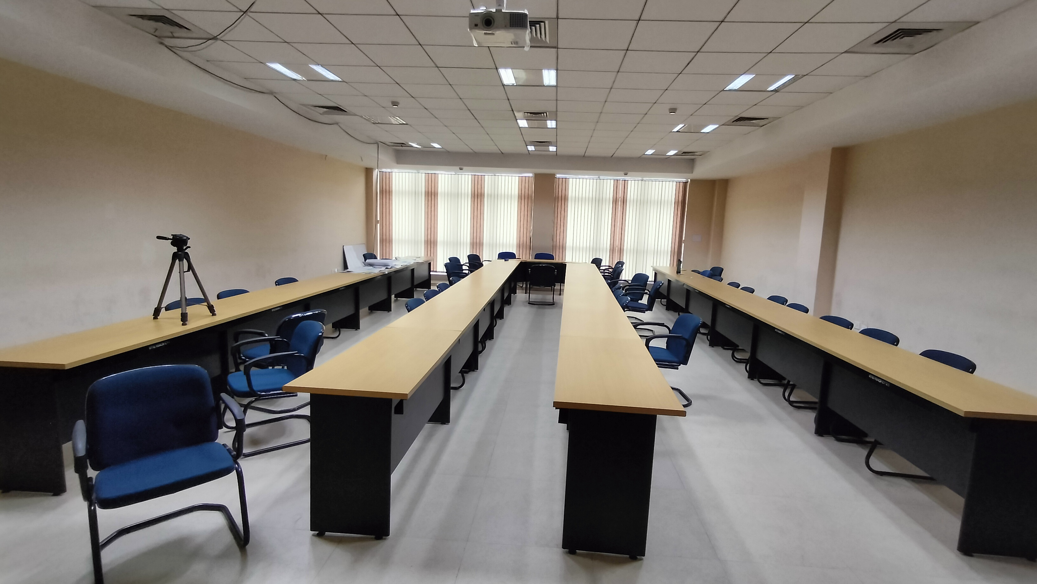

Slide 18
Heat gain through lights, peoples and electronic appliances (Ground Floor)
Hall | No. of People | Activity type | SHG (Btu/hr) | LHG (Btu/hr) | Area of Lightening | Thumb rule | Appliances | Qapp (Btu/hr) | Numbers | Sensible Heat | Latent Heat
Yoga Hall | 50 | Heavy work | 580 | 870 | 4000 | 3 | - | - |  | 25990 | 43500
Photography Club | 10 | Office work | 250 | 200 | 625 | 2 | Laptops | 307 | 3 | 2659.85 | 2000
Dance Room | 20 | Heavy work | 580 | 870 | 2100 | 3 | Sound box | 650 | 1 | 11309.7 | 17400
Conference Room | 80 | Office work | 250 | 200 | 1050 | 2 | Laptops | 307 | 10 | 16219.5 | 16000

Slide 19
Heat gain through lights, peoples and electronic appliances (First Floor)
HALL | No. of People | Activity type | SHG (Btu/hr) | LHG (Btu/hr) | Area of Lightening | Thumb rule | Appliances | Qapp (Btu/hr) | Numbers | Sensible Heat | Latent Heat
Movie Club | 10 | Light work | 250 | 200 | 1860 | 3 | Laptops | 307 | 2 | 4500.9 | 2000
Fine Art Club | 8 | Light work | 250 | 200 | 1380 | 3 | Laptops | 307 | 2 | 3497.9 | 1600
Xpression Hall | 30 | Light work | 250 | 200 | 3150 | 3 |  |  |  | 9577.5 | 6000
Robotics club | 15 | Light work | 250 | 200 | 725 | 3 | Laptops | 307 | 8 | 4500.85 | 3000
Aeromodelling club | 10 | Light work | 250 | 200 | 900 | 3 | Laptops | 307 | 5 | 3527.25 | 2000

Slide 20
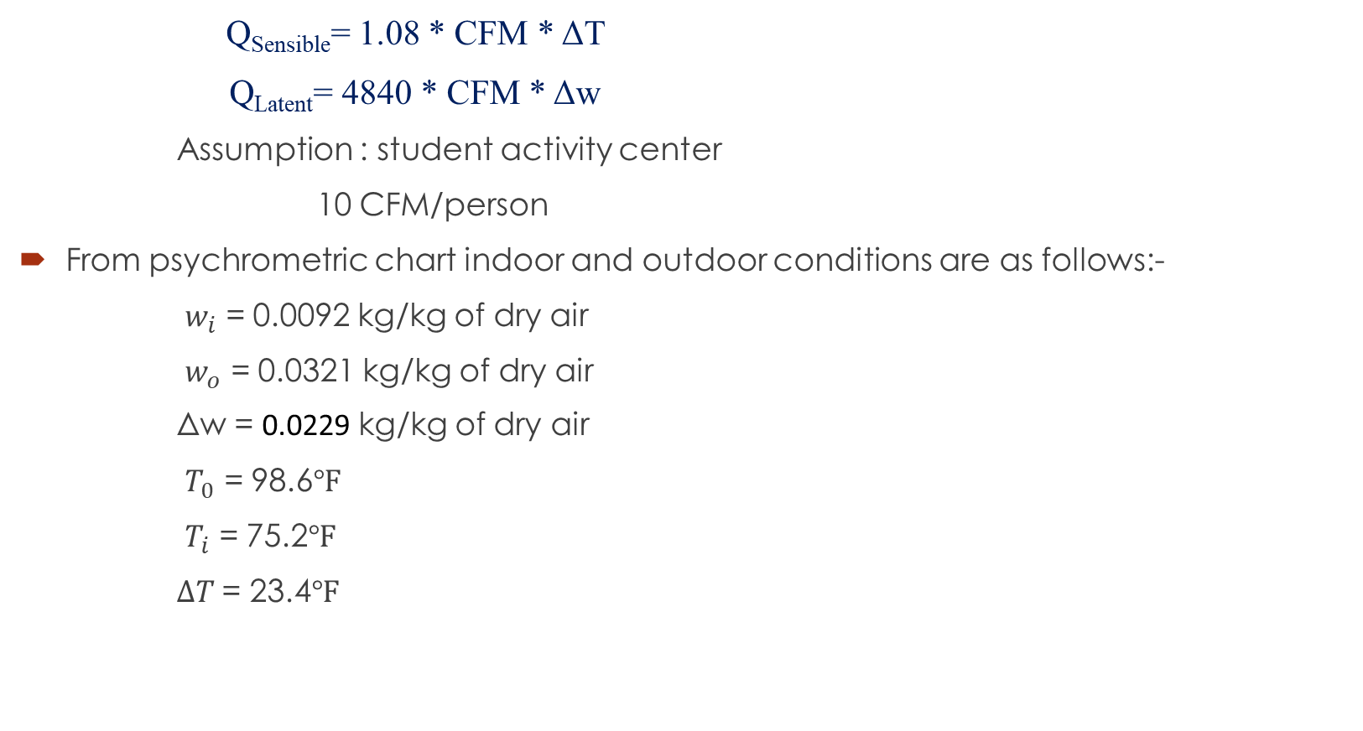
Calculation of infiltration load
Q_{Sensible}= 1.08 * CFM * ΔT
Q_{Latent}= 4840 * CFM * Δw
Assumption : student activity center
10 CFM/person
From psychrometric chart indoor and outdoor conditions are as follows:-
$w_{i}$ = 0.0092 kg/kg of dry air
$w_{o}$ = 0.0321 kg/kg of dry air
Δw = 0.0229 kg/kg of dry air
$T_{0}$ = 98.6$℉$
$T_{i}$ = 75.2$℉$
$∆T$= 23.4$℉$

Slide 21
Calculation for infiltration & ventilation load
INFILTRATION
Q_{Sensible}= 1.08 * CFM * ΔT*N where, N=No. Of people
= 1.08*10*23.4*223 Wc=0.0061 kg/kg of dry air
= 56356.56 Btu/hr
Q_{Latent}= 4840 * CFM * Δw*N
=4840*10* 0.0229 *223
= 247164.3 Btu/hr
VENTILATION
Q_{sensible} = 1.08*CFM*ΔTc*N
= 1.08*10*54*223
= 130053.6 Btu/hr
Q_{latent} = 4840*Δw_{c}*CFM*N
= 4840*0.026*10*223
= 280623.2 Btu/hr

Slide 22
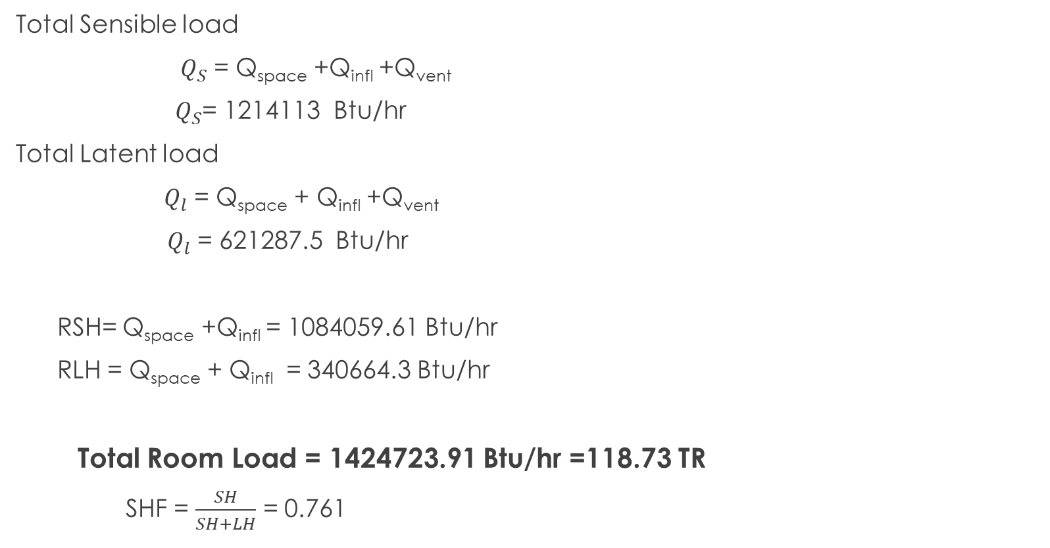
Calculation for total load
Total Sensible load
${ Q}_{S}$ = Q_{space} +Q_{infl} +Q_{vent}
${ Q}_{S}$= 1214113 Btu/hr
Total Latent load
${ Q}_{l}$ = Q_{space} + Q_{infl} +Q_{vent}
$Q_{l}$ = 621287.5 Btu/hr
RSH= Q_{space} +Q_{infl} = 1084059.61 Btu/hr
RLH = Q_{space} + Q_{infl} = 340664.3 Btu/hr
Total Room Load = 1424723.91 Btu/hr =118.73 TR
SHF = $\frac{SH}{SH+LH}$ = 0.761

Slide 23
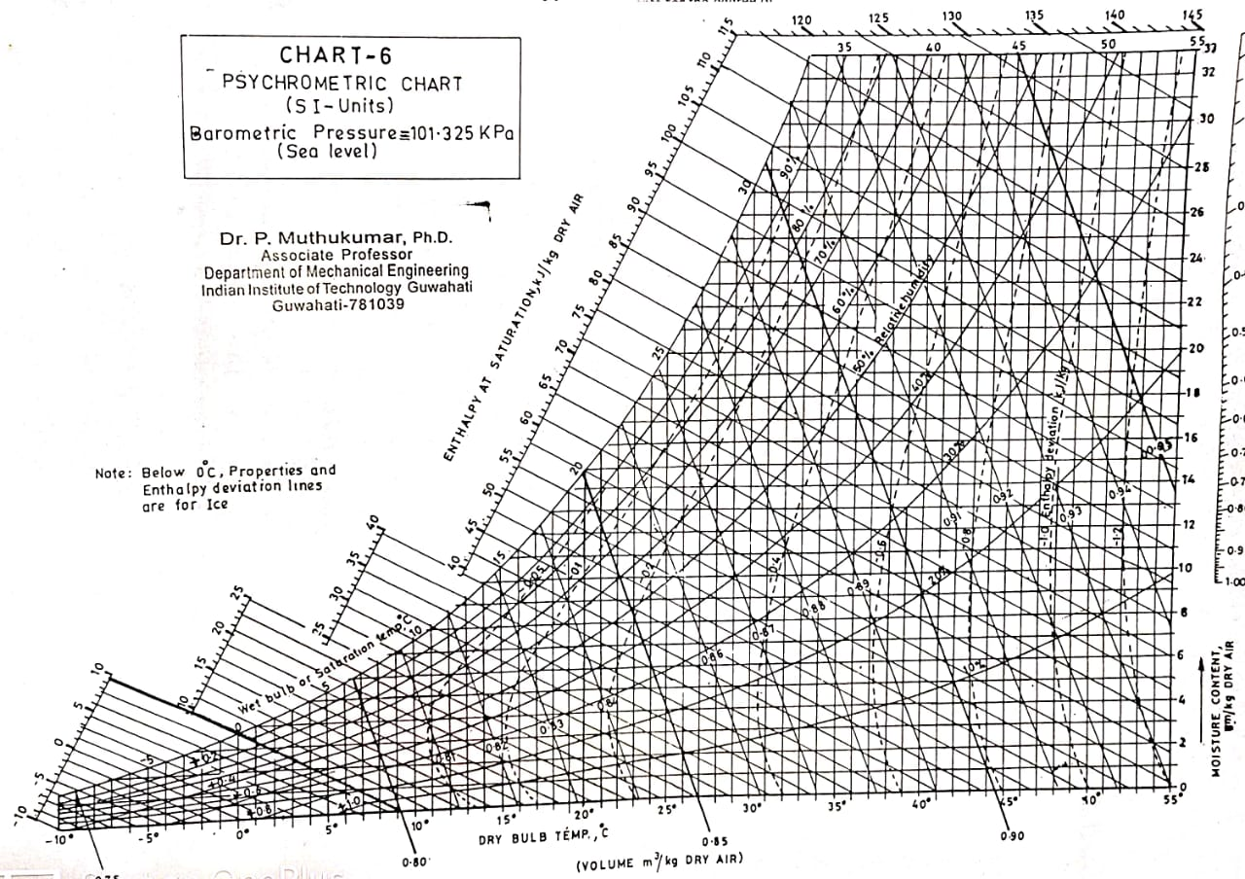
a
c
b
d
e
f

Slide 24
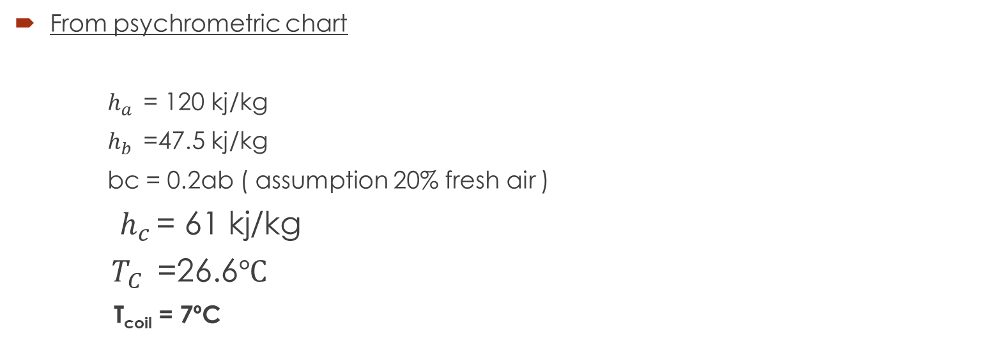
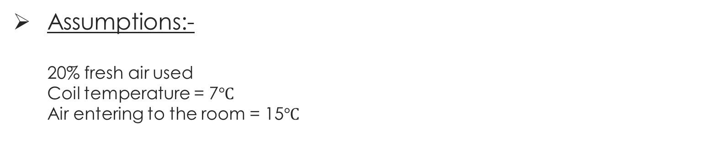
Assumptions:- 20% fresh air used Coil temperature = 7$℃$ Air entering to the room = 15$℃$
From psychrometric chart
$h_{a }$ = 120 kj/kg
$h_{b }$ =47.5 kj/kg
bc = 0.2ab ( assumption 20% fresh air )
${ h}_{c }$= 61 kj/kg
$T_{C }$ =26.6$℃$
T_{coil} = 7ºC

Slide 25
Temperature and enthalpy of various points
points | T º C | h (kj/kg)
a | 37 | 120
b | 24 | 48
c | 26.6 | 61
d | 11.6 | 31.9
e | 15 | 36
f | 7 | 23

Slide 26
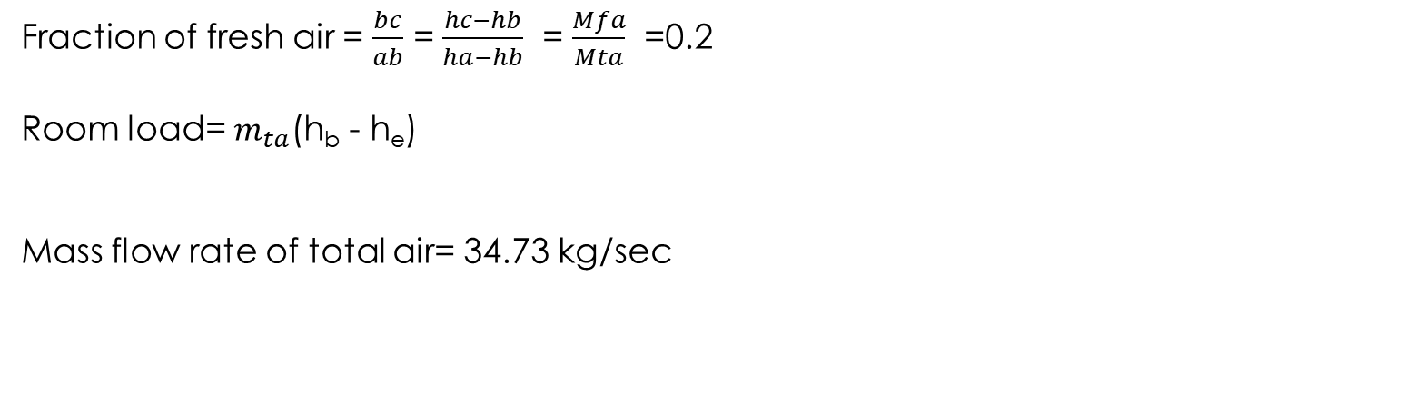


Bypass factor for cooling coil = $\frac{h_{d}−h_{f}}{h_{c}−h_{f}}$
Bypass factor = 0.234
Fraction of fresh air = $\frac{bc}{ab}$ = $\frac{hc−hb}{ha−hb}$ = $\frac{Mfa}{Mta}$ =0.2
Room load= $m_{ta}$(h_{b} - h_{e})
Mass flow rate of total air= 34.73 kg/sec
Mass flow rate of fresh air =6.945 kg/sec
Capacity of cooling coil= $m_{ta}×$(h_{c} - h_{d})
=1010.57 kw
= 287.91 TR
Capacity of heating coil= $m_{ta}×$(h_{e} - h_{d})
= 142.38 KW

Slide 28
Thank You

